Slide 1


基于pot 的zero-shot reasoner
《Automatic Chain of Thought Prompting in Large Language Models》2022
《Program of Thoughts Prompting: Disentangling Computation from Reasoning for Numerical Reasoning Tasks》-2022
《Large Language Models are Zero-Shot Reasoners》-2023

Slide 2
《 Automatic Chain of Thought Prompting in Large Language Models 》

Slide 3
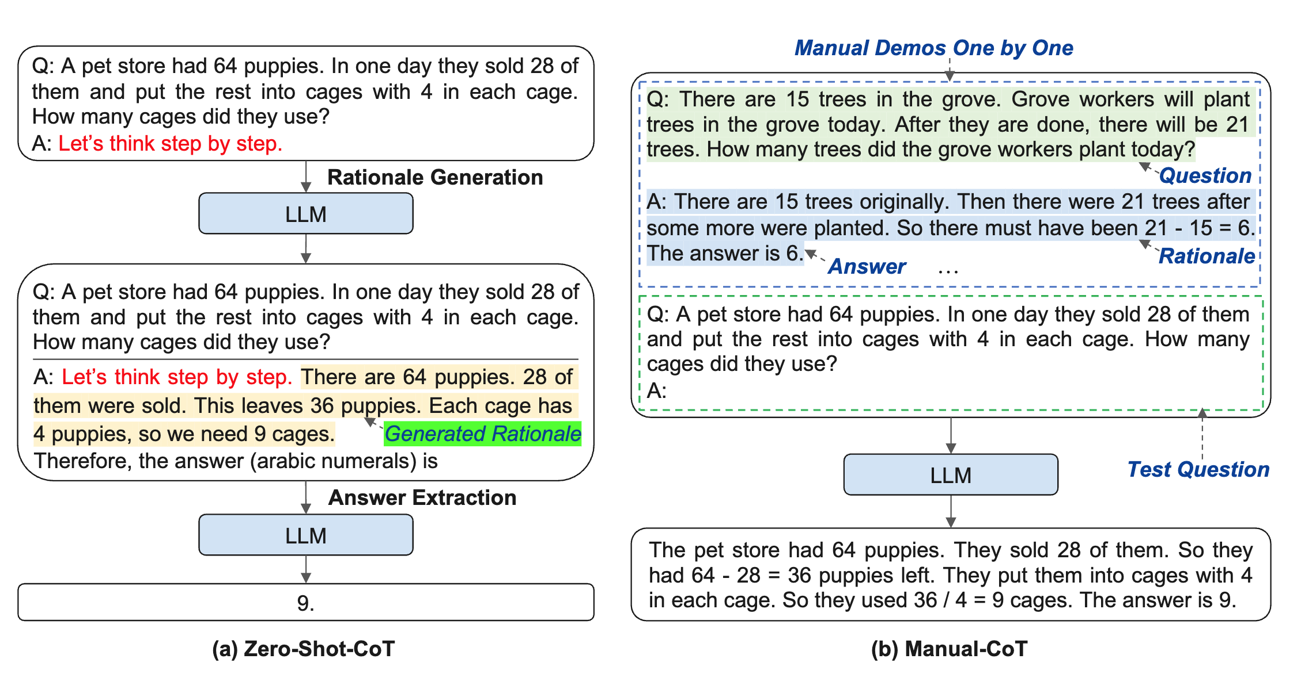
Background
CoT 提示有两种主要范式。一个人利用一个简单的提示，如“Let’s think step by step”来促进在回答问题之前逐步思考,没有用任何演示被称为Zero-shot Cot。
另一种是用一个手动演示，每个演示由一个问题和一个导致答案的推理链组成,因此也被称作Manual cot 。第二个范式的卓越性能取决于一一手工制作特定于任务的演示。
为了消除这一因素的影响，作者提出Auto-Cot 范式来自动构建带有问题和推理链的演示

Slide 4
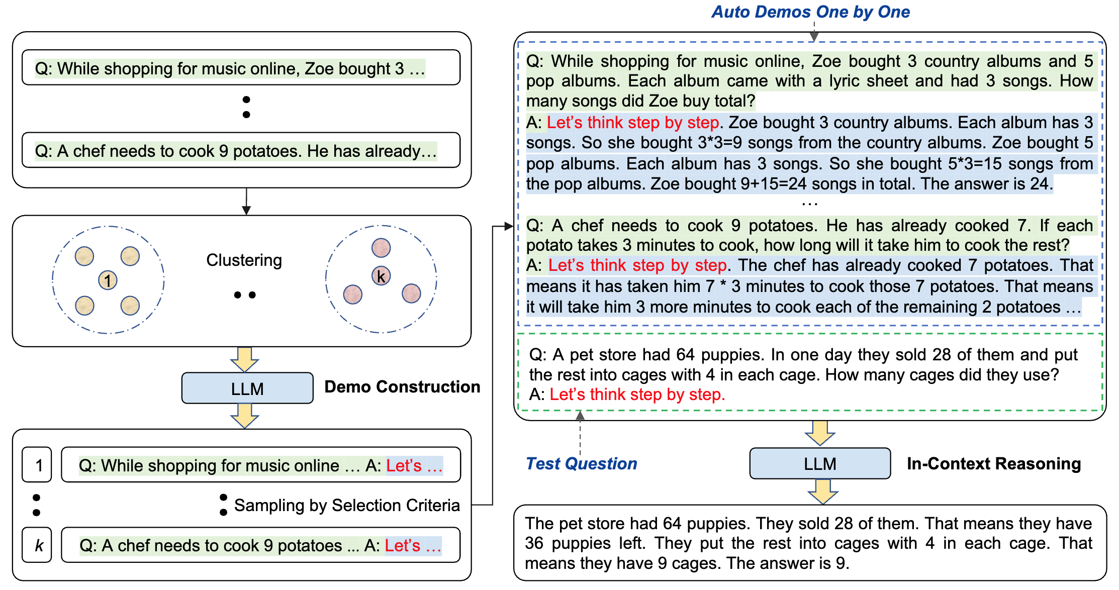
Method & Challenge
Auto-CoT利用llm和“Let’s think step by step”提示逐个生成演示推理链，即让let's think not just step by step, but also one by one
llm 生成的Cot 往往存在推理错误，为了减轻此类错误的影响，我们发现多样性对于自动构建演示很重要。

Slide 5
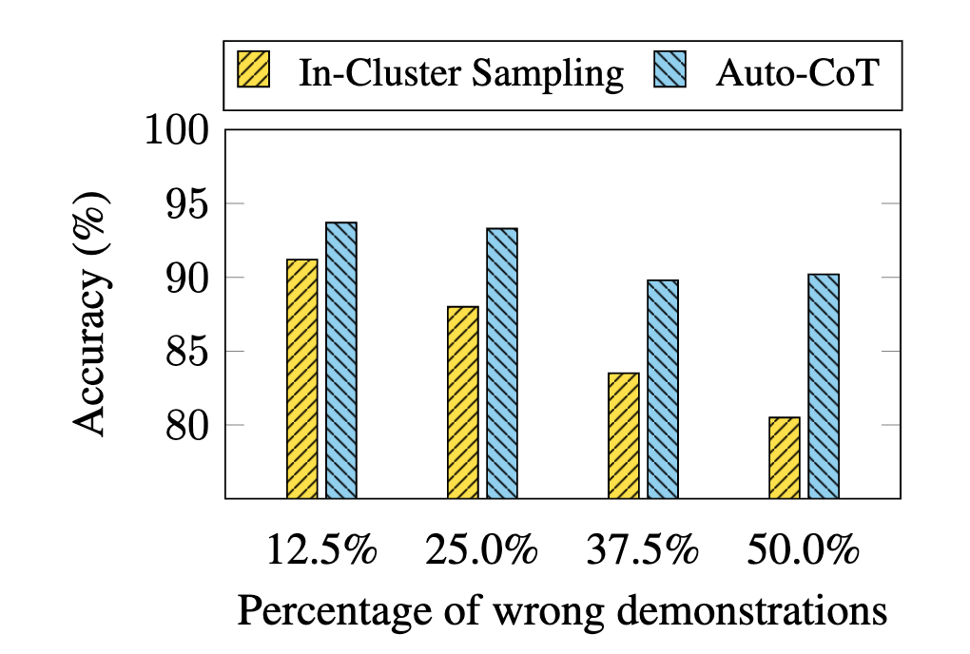
Experiment
为了查看多样性是否减轻了这种影响，我们设计了一个 In-Cluster Sampling 基线，该基线通过从包含测试问题的同一集群中随机抽取问题来构建演示。图 6 比较了 MultiArith 上不同数量的错误演示的准确性。与 In-Cluster Sampling 相比，Auto-CoT（使用基于多样性的聚类）受到错误演示的影响较小：即使呈现 50% 的错误演示，它的性能仍然不会显着下降。

Slide 6
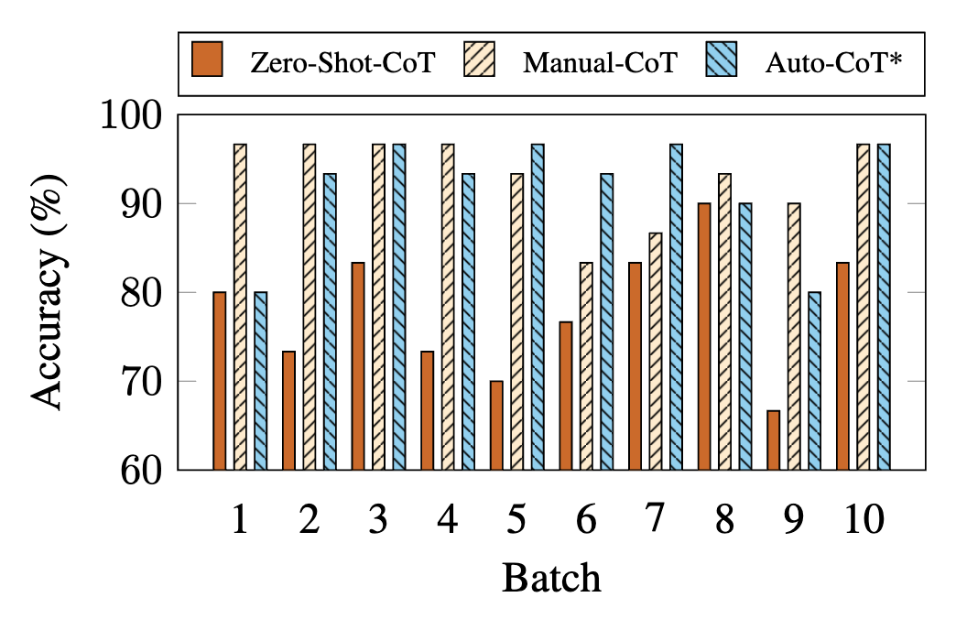
More Challenging Streaming Setting
Bootstraping for the streaming setting:CoT 研究通常假设给出了一个带有测试问题的完整数据集 。基于给定的数据集，Auto-CoT 对问题进行采样以构建演示。尽管如此，现在我们考虑一个更具挑战性的流设置，其中小批量测试问题（例如 m 个问题）一次到达，就像在数据流中一样。

Slide 7
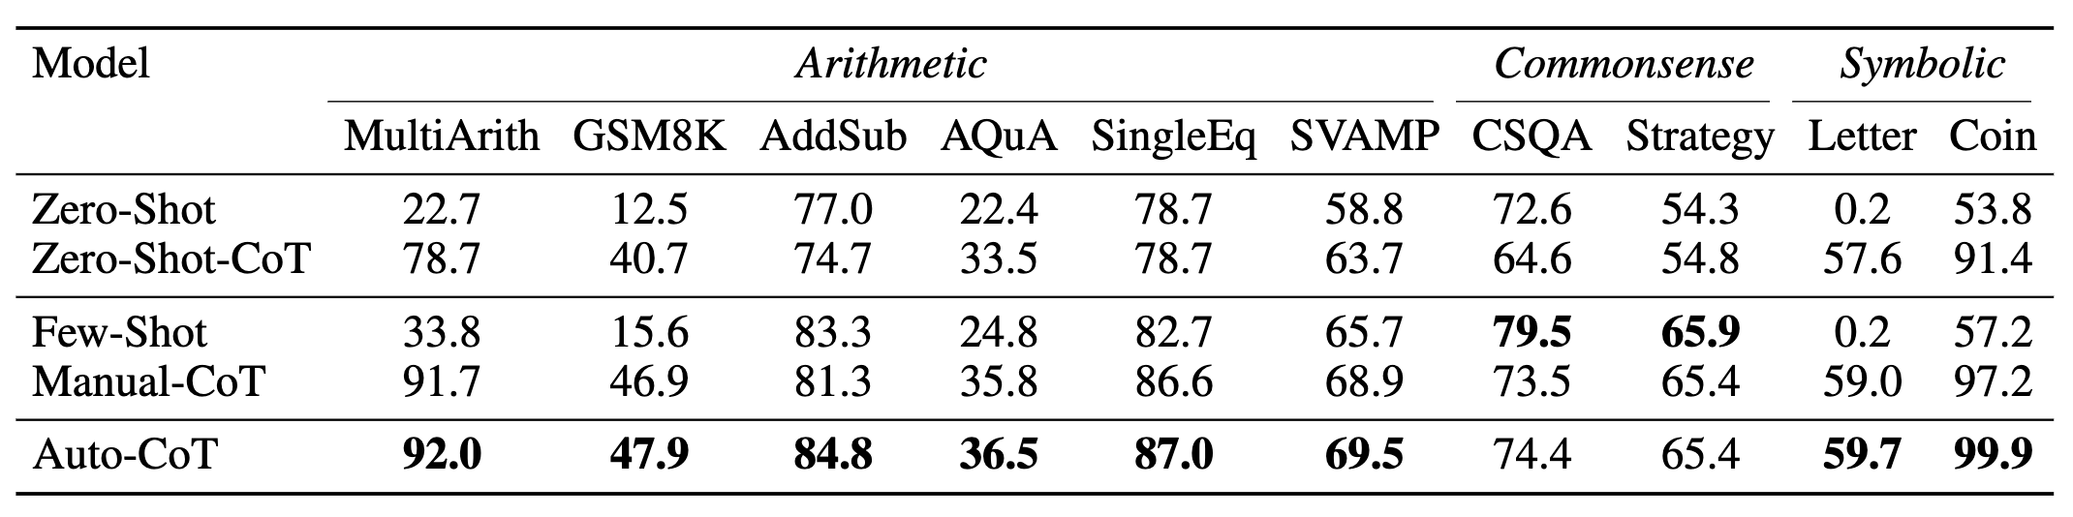
Experiment

Slide 8
Conclusion
对具有多样性的问题进行采样并生成推理链来构建演示。十个公共基准推理数据集上的实验结果表明，使用 GPT-3，Auto-CoT 始终匹配或超过需要手动设计演示的 CoT 范式的性能。

Slide 9
《 Program of Thoughts Prompting: Disentangling Computation from Reasoning for Numerical Reasoning Tasks 》

Slide 10
BackGround
思维链提示 (CoT) 是其中许多任务的最新方法。CoT 使用语言模型来生成描述推理和计算的文本，最后是问题的答案。
作者提出了“Loughts”（PoT）的“Program，它使用语言模型（主要是Codex）来生成文本和编程语言语句，最后是答案。在 PoT 中，计算可以委托给程序解释器，用于执行生成的程序，从而将复杂的计算与推理和语言理解解耦。

Slide 11
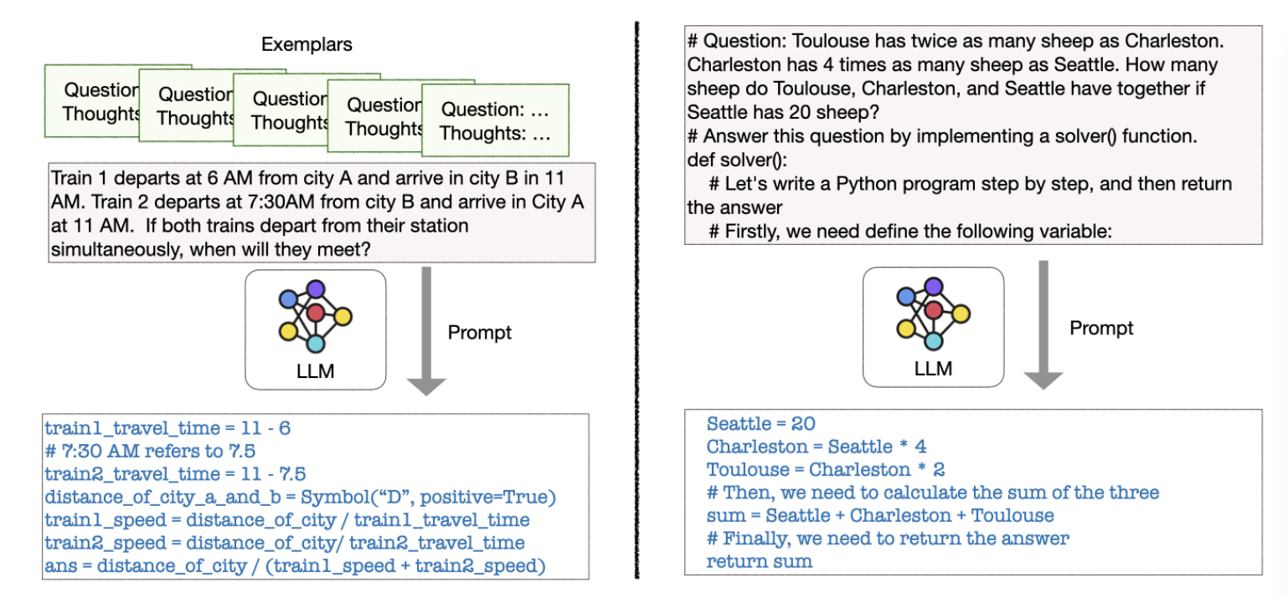
Method
在 zeroshot 设置下，提示仅包含没有任何示例演示的指令。与 zeroshot CoT (Kojima et al., 2022) 不同，这需要一个额外的步骤来从“思想链”中提取答案
在few-shot 设置下，一些（question,’program of thoughts’）的示例将作为演示前缀，以教 LLM 如何生成“thoughtful ”的程序。

Slide 12
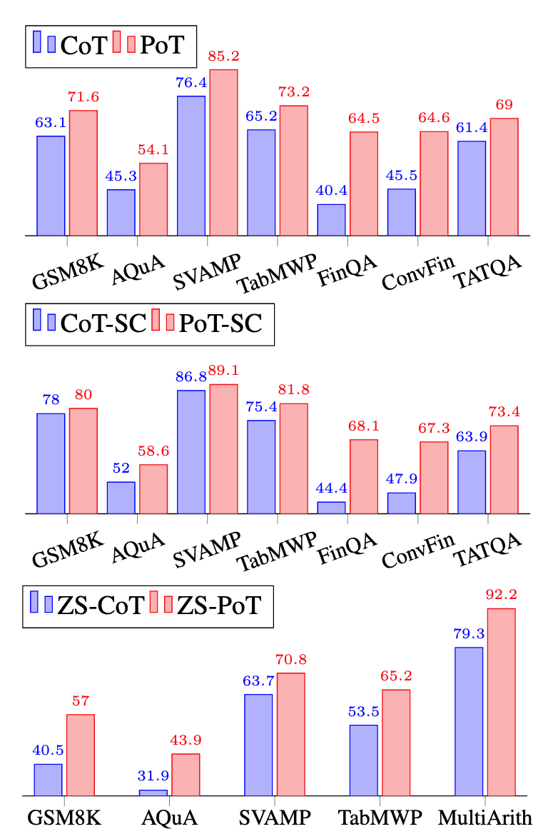
Experiment
数学题 | MWP datasets, GSM8K, AQuA, SVAMP, TabMWP
金融 | FinQA，vFinQA，TATQA.
在few-shot和zero-shot设置下，PoT 在所有评估数据集上都显着优于 CoT。在few-shot设置下，MWP 数据集的平均增益约为 8%在零样本设置下，MWP 数据集对 CoT 的平均增益约为 12%。PoT 与自洽 (SC) 相结合也优于CoT+SC (Wang et al., 2022b) 在所有数据集中平均 10%。我们的 PoT+SC 在所有评估的 MWP 数据集和金融数据集上的接近 SoTA 结果上都取得了最著名的结果。最后，我们进行了全面的消融研究，以了解 PoT 的不同组成部分。

Slide 13
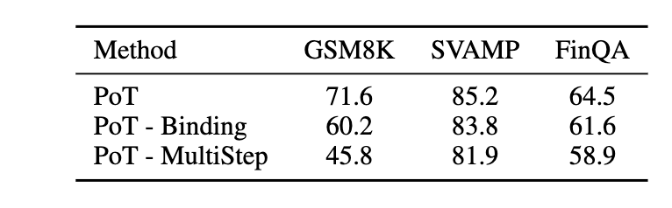
Experiment
Comparison between PoT and equation generation on three different datasets.
PoT 从两个方面与方程生成不同：
（1）PoT 将方程分解为多步“思想”过程
（2）PoT 将语义含义绑定到变量以帮助将模型置于语言中
可以看出，删除绑定通常会损害模型的性能。在涉及 GSM8K 等更多变量的更复杂的问题上，性能下降更大。同样，促使llm直接生成目标方程也非常具有挑战性。将目标方程分解为多个推理步骤有助于提高性能。

Slide 14
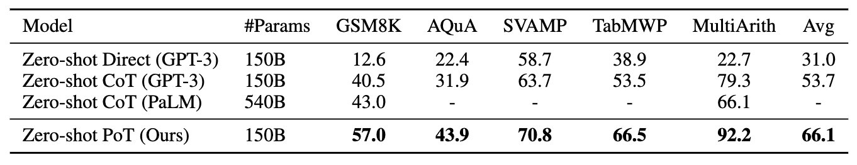
Experiment
Zero-shot 上PoT的潜力:
在所有评估的 MWP 数据集上，zeroshot PoT 显着优于zero-shot CoT。
与few-shot提示相比，零样本 PoT 大大优于零样本 CoT 。
在评估的数据集上，PoT 平均优于 CoT 12%。在 TabMWP 上，zero-shot PoT 甚至高于few-shot CoT。
这些结果显示了在没有任何特定于数据集的示例的情况下直接泛化到许多看不见的数值任务的巨大潜力。

Slide 15
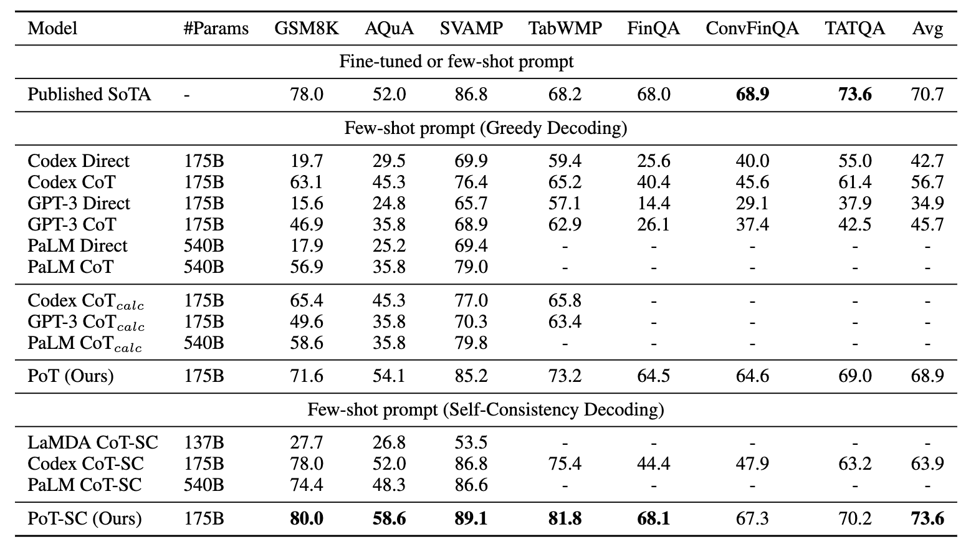
Experiment
PoT + SC 在 MWP 数据集上仍然大大优于 CoT + SC。在金融数据集上，我们观察到自洽解码对 PoT 和 CoT 的影响较小。同样，PoT + SC 在 FinQA/ConvFinQA 上分别比 CoT + SC 高出约 20%，在 TATQA 上高出 7%

Slide 16
Conclusion
通过将 PoT 与自洽解码相结合，我们可以在所有数学数据集和金融数据集上接近 SoTA 性能上实现 SoTA 性能

Slide 17
《 Prompt Space Optimizing Few-shot Reasoning Success with Large Language Models》

Slide 18
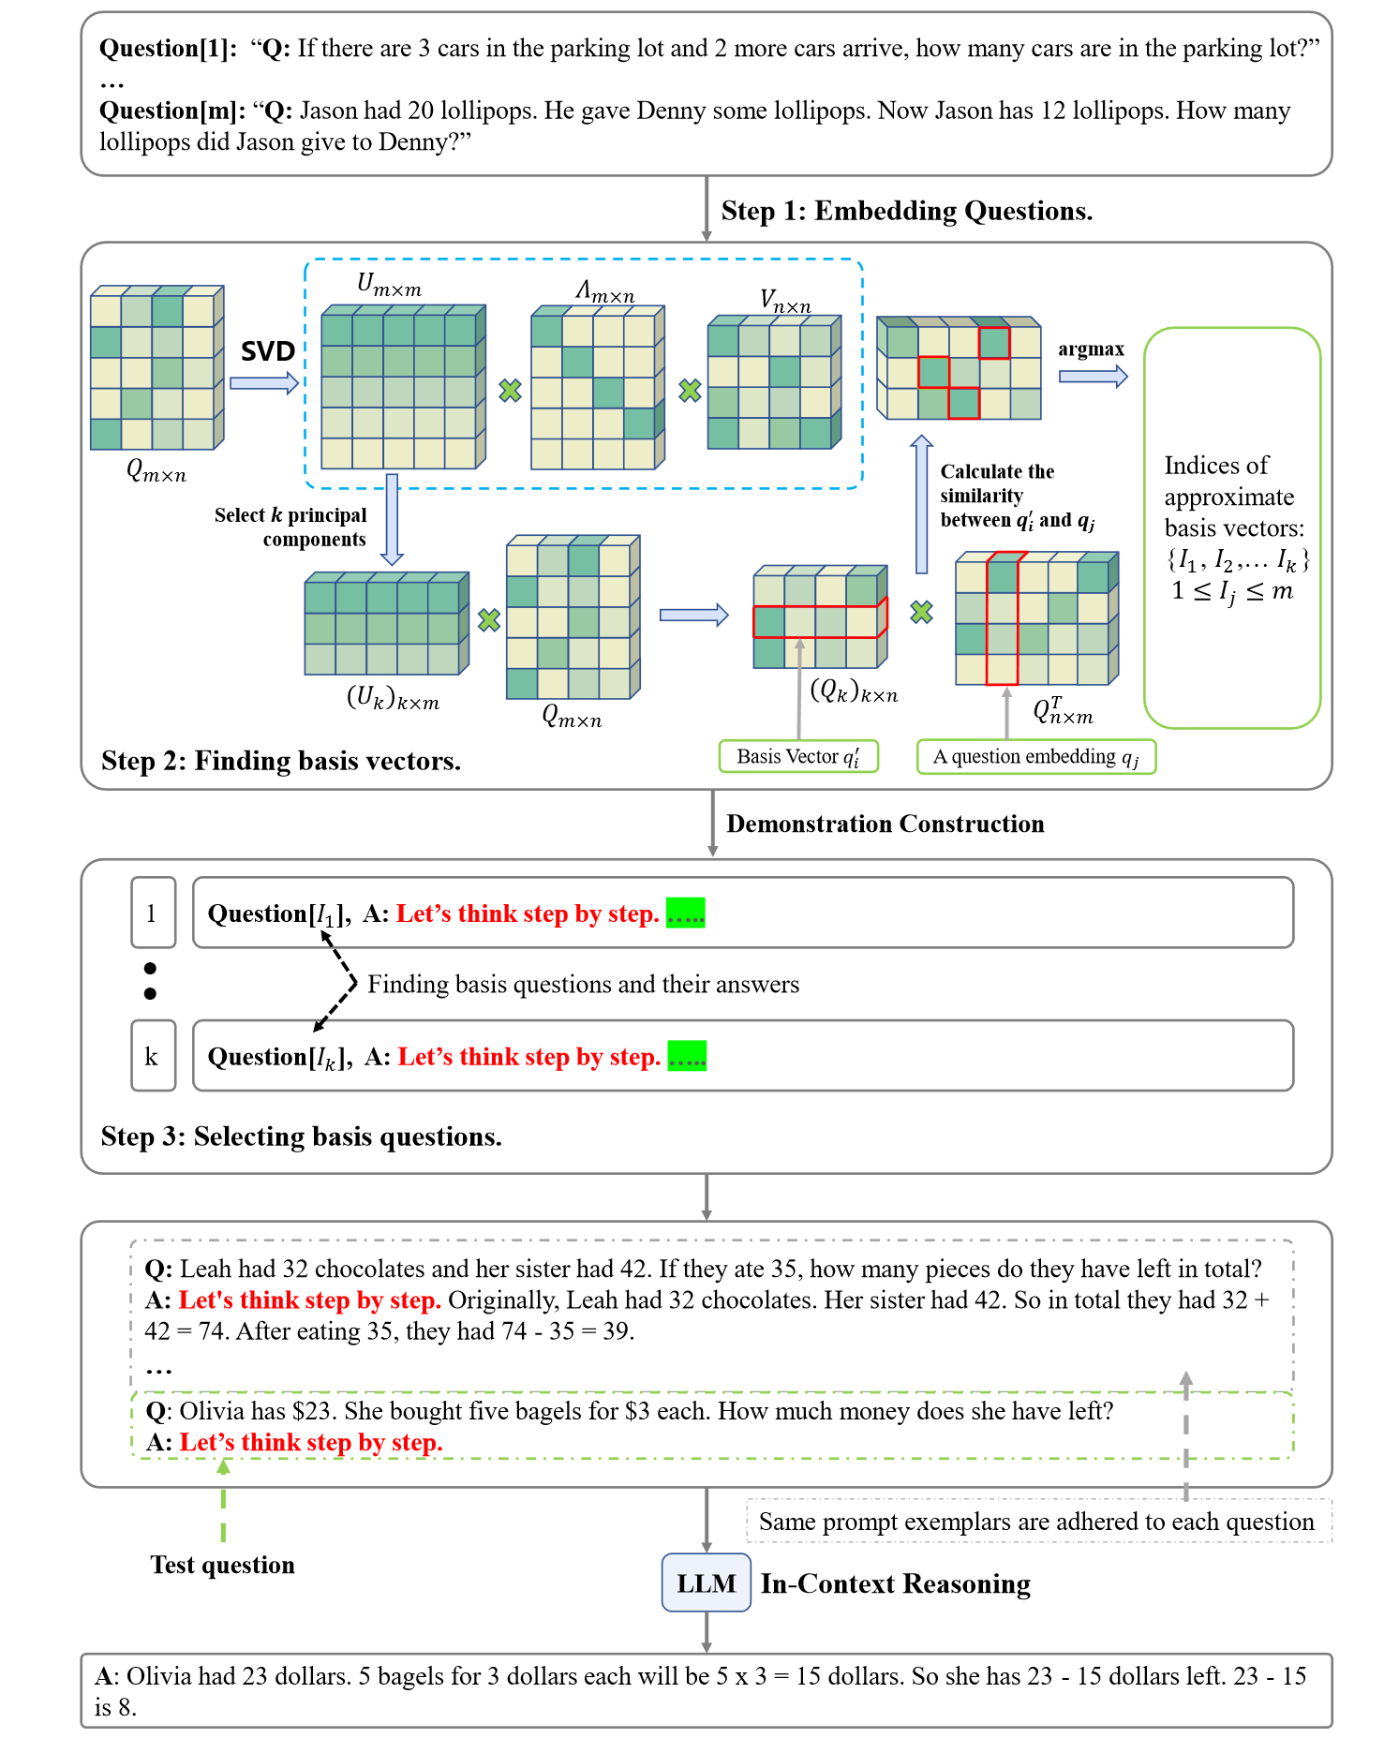
Prompt Space

Slide 19
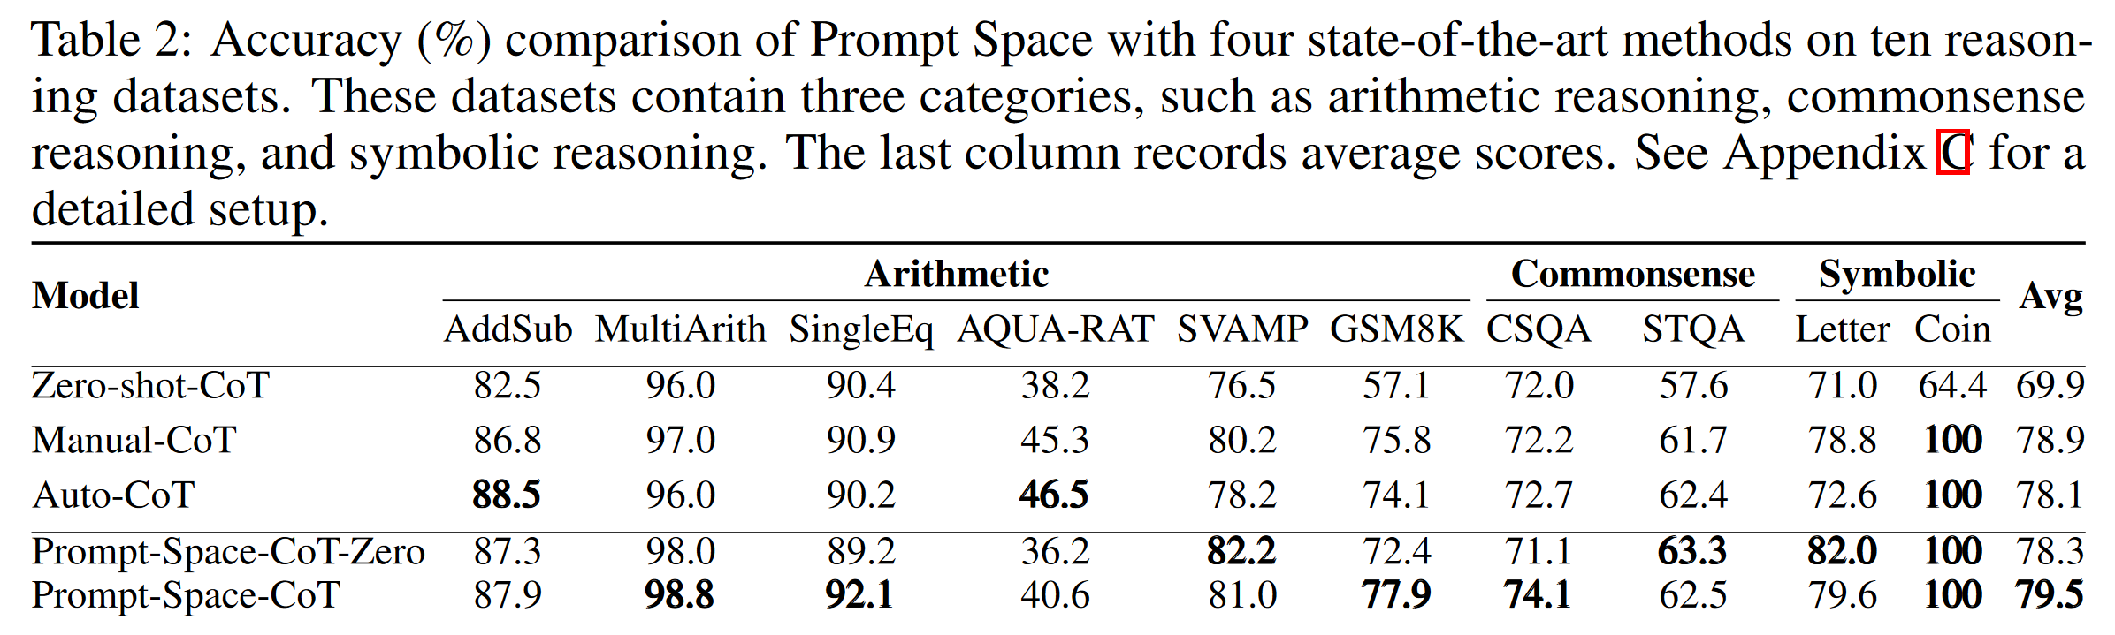
Prompt Space

Slide 20
方法实践

Slide 21
Auto_pot
影响In_context learning 的表现的因素：(1) the label space, (2) the distribution of the input text, and (3) the overall format of the sequence.
Self consistency 可以提高效果

Slide 22
Prompt设计:zero-shot phase
Cot->pot:
Let’s think step by step
import math import numpy as np {question} # Let's think step by step to derive the answer, store the result as a 'ans' variable: # According to the question, we can define the variables:

Slide 23
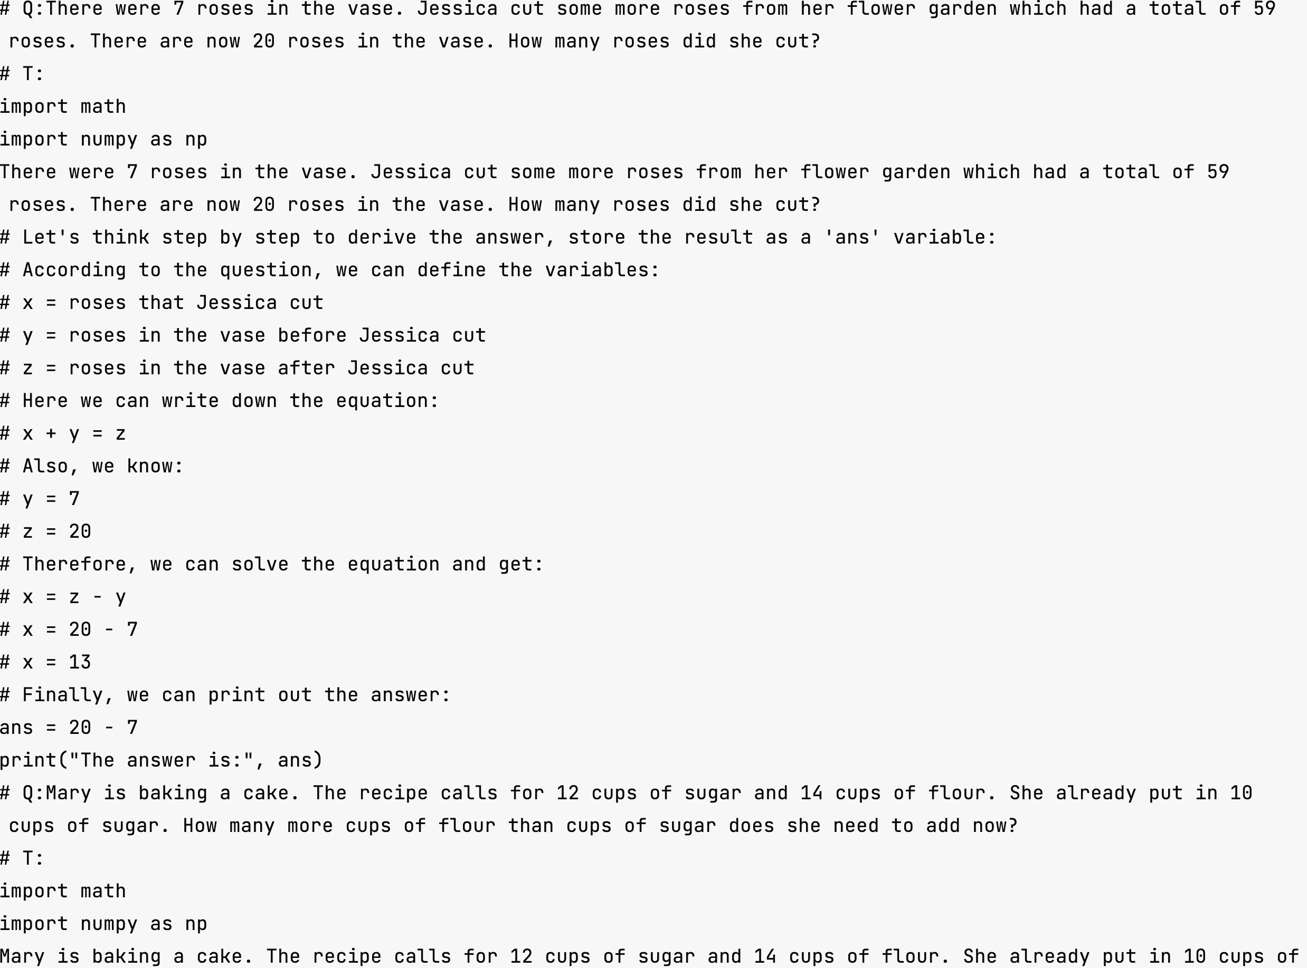
Prompt设计-few-shot pharse

Slide 24
聚类8个问题
{ "question": "Jake has 6 fewer peaches and 8 more apples than Steven. Steven has 17 peaches and 16 apples. How many more peaches than apples does Steven have?", "rationale": "\nimport math\nimport numpy as np\nJake has 6 fewer peaches and 8 more apples than Steven. Steven has 17 peaches and 16 apples. How many more peaches than apples does Steven have?\n# Let's think step by step to derive the answer, store the result as a 'ans' variable:\n# According to the question, we can define the variables:\n# Let's define the variable 'peaches' and 'apples' for Jake and Steven,…….\nprint(\"The answer is\", ans)", "pred_ans": 7.0, "gold_ans": 1.0 }

Slide 25
聚类8个问题
{ "question": "Paul got a box of 589 crayons for his birthday. During the school year he gave 571 crayons to his friends while he lost 161 crayons. How many more crayons did he give to his friends than those he lost?", "rationale": "\nimport math\nimport numpy as np\nPaul got a box of 589 crayons for his birthday. During the school year he gave 571 crayons to his friends while he lost 161 crayons. How many more crayons did he give to his friends than those he lost?\n# Let's think step by step to derive the answer, store the result as a 'ans' variable:\n# According to the question, we can define the variables:\n# 'box' crayons = 589 crayons\n# 'given' crayons = 571 crayons\n# 'lost' crayons = 161 crayons\nbox = 589\ngiven = 571\nlost = 161\nans = given - lost\nprint(ans)", "pred_ans": 410.0, "gold_ans": 410.0 }

Slide 26
聚类8个问题
{ "question": "Baker made 13 cakes. He sold 91 of them and bought 154 new cakes. How many more cakes did baker buy than those he sold?", "rationale": "\nimport math\nimport numpy as np\nBaker made 13 cakes. He sold 91 of them and bought 154 new cakes. How many more cakes did baker buy than those he sold?\n# Let's think step by step to derive the answer, store the result as a 'ans' variable:\n# According to the question, we can define the variables:\n# x = Number of cakes baker sold\n# y = Number of cakes baker bought\n# We can then write down the equation:\n# 13 = 91 - x + 154 - y\n# We can rearrange the equation to get:\n# x = 91 - 13 + 154 - y\n# x = 232 - y\n# We can then substitute the value of 'x' into the original equation:\n# 13 = 91 - 232 + 154 - y + y\n# 13 = 91 + 154 - y - y\n# 13 = 245 - y\n# We can then rearrange the equation to get:\n# y = 245 - 13\n# y = 232\n# Therefore, the answer is 232.\nans = 232", "pred_ans": 232.0, "gold_ans": 63.0 }

Slide 27
聚类8个问题
{ "question": "Rachel had to complete 4 pages of reading homework, 7 pages of math homework and 19 more pages of biology homework. How many more pages of math homework than reading homework did she have?", "rationale": "\nimport math\nimport numpy as np\nRachel had to complete 4 pages of reading homework, 7 pages of math homework and 19 more pages of biology homework. How many more pages of math homework than reading homework did she have?\n# Let's think step by step to derive the answer, store the result as a 'ans' variable:\n# According to the question, we can define the variables:\n# reading_homework: 4\n# math_homework: 7\n# biology_homework: 19\n# math_homework_difference: math_homework - reading_homework\n# ans: math_homework_difference\n# Now, let's calculate the answer:\nreading_homework = 4\nmath_homework = 7\nbiology_homework = 19\nmath_homework_difference = math_homework - reading_homework\nans = math_homework_difference\nprint(\"There are\",ans,\"more pages of math homework than reading homework.\")", "pred_ans": 3.0, "gold_ans": 3.0 }

Slide 28
聚类8个问题
{ "question": "36 children were riding on the bus. At the bus stop 68 children got off the bus while some more got on the bus. Then there were 12 children altogether on the bus. How many more children got off the bus than those that got on?", "rationale": "\nimport math\nimport numpy as np\n36 children were riding on the bus. At the bus stop 68 children got off the bus while some more got on the bus. Then there were 12 children altogether on the bus. How many more children got off the bus than those that got on?\n# Let's think step by step to derive the answer, store the result as a 'ans' variable:\n# According to the question, we can define the variables:\n# childrenOnTheBus = 36\n# childrenOffTheBus = 68\n# childrenOnTheBusAfterOffTheBus = 12\n# the number of children that got off the bus:\n# childrenOffTheBus - childrenOnTheBusAfterOffTheBus = 56\n# the number of children that got on the bus:\n# childrenOnTheBusAfterOffTheBus - childrenOnTheBus = 24\n# the number of more children that got off the bus than those that got on:\n# childrenOffTheBus - childrenOnTheBusAfterOffTheBus - (childrenOnTheBusAfterOffTheBus - childrenOnTheBus) = 56 - 24 = 32\n# So the answer is 32\nans = 68 - 12 - (12 - 36)\nprint(ans)", "pred_ans": 80.0, "gold_ans": 24.0 }

Slide 29
聚类8个问题
{ "question": "He then went to see the oranges being harvested. He found out that they harvest 66 sacks per day and that each sack containes 25 oranges. How many oranges will they have after 87 days of harvest?", "rationale": "\nimport math\nimport numpy as np\nHe then went to see the oranges being harvested. He found out that they harvest 66 sacks per day and that each sack containes 25 oranges. How many oranges will they have after 87 days of harvest?\n# Let's think step by step to derive the answer, store the result as a 'ans' variable:\n# According to the question, we can define the variables:\n# days: 87\n# sacks_per_day: 66\n# oranges_per_sack: 25\n# ans: ?\ndays = 87\nsacks_per_day = 66\noranges_per_sack = 25\nans = days * sacks_per_day * oranges_per_sack\nprint(ans)", "pred_ans": 143550.0, "gold_ans": 143550.0 }

Slide 30
聚类8个问题
{ "question": "Last week Fred had 60 dollars and Jason had 19 dollars. Jason washed cars over the weekend and now has 33 dollars. How much money did Jason make washing cars?", "rationale": "\nimport math\nimport numpy as np\nLast week Fred had 60 dollars and Jason had 19 dollars. Jason washed cars over the weekend and now has 33 dollars. How much money did Jason make washing cars?\n# Let's think step by step to derive the answer, store the result as a 'ans' variable:\n# According to the question, we can define the variables:\nFred = 60\nJason = 19\n# After washing cars, Jason has 33 dollars, so we can define:\nJason = 33\n# Jason made 14 dollars, so we can define:\nans = 14\n# Finally, we can print the result:\nprint(ans)", "pred_ans": 14.0, "gold_ans": 14.0 }

Slide 31
聚类8个问题
{ "question": "There were 7 roses in the vase. Jessica cut some more roses from her flower garden which had a total of 59 roses. There are now 20 roses in the vase. How many roses did she cut?", "rationale": "\nimport math\nimport numpy as np\nThere were 7 roses in the vase. Jessica cut some more roses from her flower garden which had a total of 59 roses. There are now 20 roses in the vase. How many roses did she cut?\n# Let's think step by step to derive the answer, store the result as a 'ans' variable:\n# According to the question, we can define the variables:\n# x = roses that Jessica cut\n# y = roses in the vase before Jessica cut\n# z = roses in the vase after Jessica cut\n# Here we can write down the equation:\n# x + y = z\n# Also, we know:\n# y = 7\n# z = 20\n# Therefore, we can solve the equation and get:\n# x = z - y\n# x = 20 - 7\n# x = 13\n# Finally, we can print out the answer:\nans = 20 - 7\nprint(\"The answer is:\", ans)", "pred_ans": 13.0, "gold_ans": 13.0 }

Slide 32
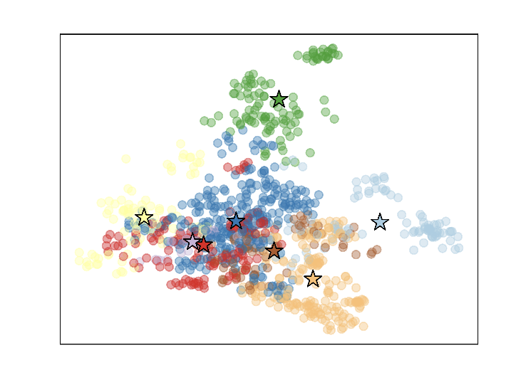
问题词向量空间
Encoder:all-MiniLM-L6-v

Slide 33
各种方法对比
方法 | 结果Accuracy
Auto_cot | 69.5%
Zero_shot_pot | 70.8%
auto_pot | 83%

Slide 34
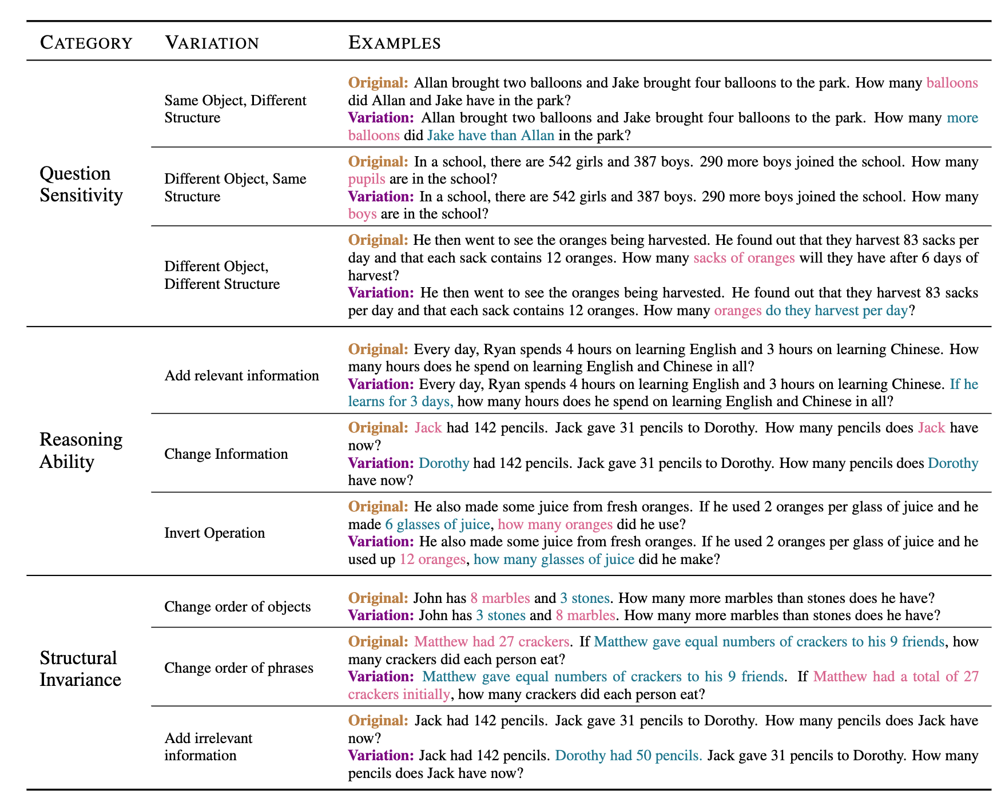
错例分析
Are NLP Models really able to Solve Simple Math Word Problems?

Slide 35
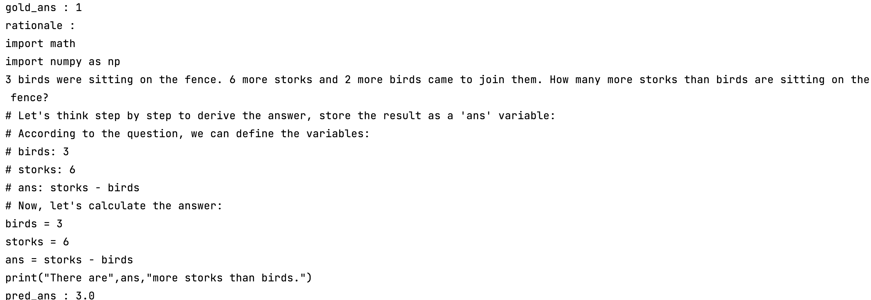
错例分析

Slide 36
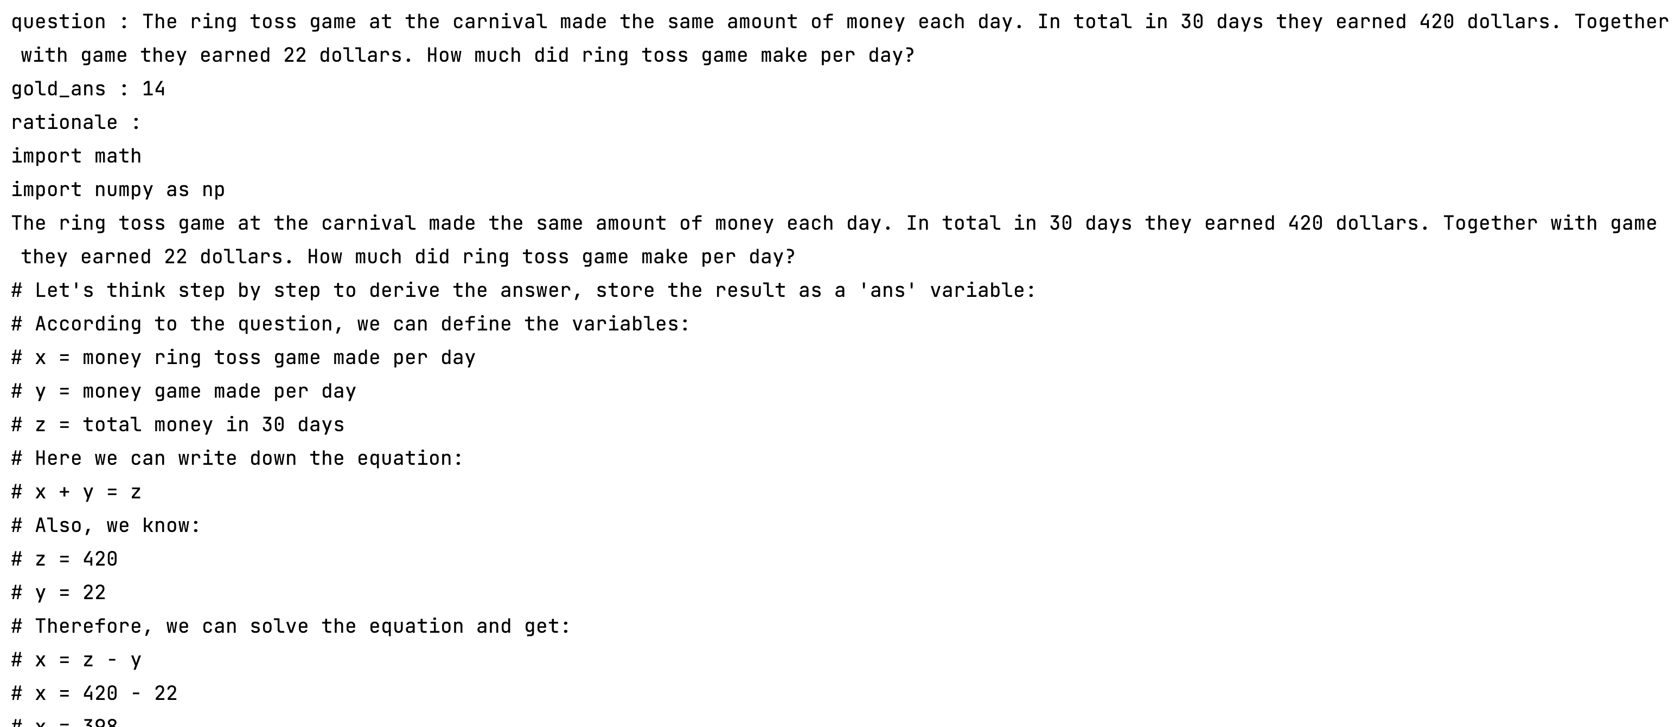
错例分析

Slide 37
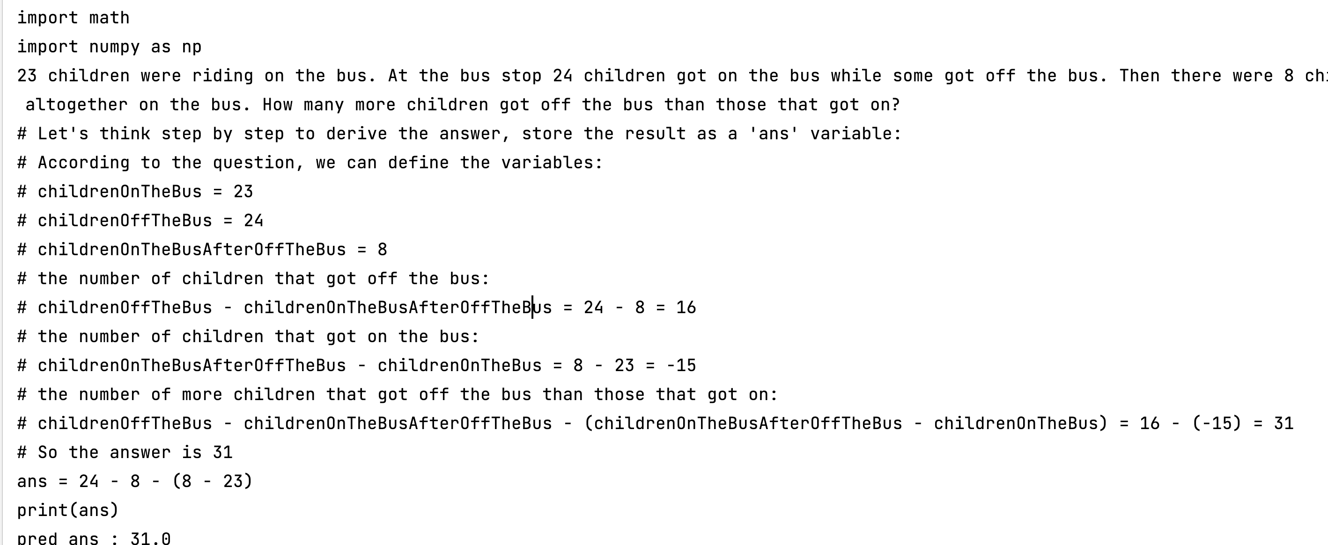
错例分析

Slide 38
错例分析
抄错数字的问题：
按理说pot的思路中间不用计算，而用绑定语义的变量完成整个推理

Slide 39
实验计划
多次尝试尽可能让auto_pot的zero_shot phase 对
设计好prompt 完成变量的名的
在全量数据上实验
Let’s think step by step 是否要在few-shot 阶段引入
Semantic binding 需不需要

Slide 40
实验结果
Zero_prompt | Few_prompt | notes | Accuracy
 |  | Code 不需要之间执行计算的过程 | 83%
 |  | 在test的问题后面加入zero_shot的提示 | 79%
 |  | 试图提示它要绑定变量名语义 无效，又把它给每个变量赋值的原则忘记了
 |  | 把zero-shot使用的prefix加入答案，few-shot 阶段使用 | 88%

Slide 41
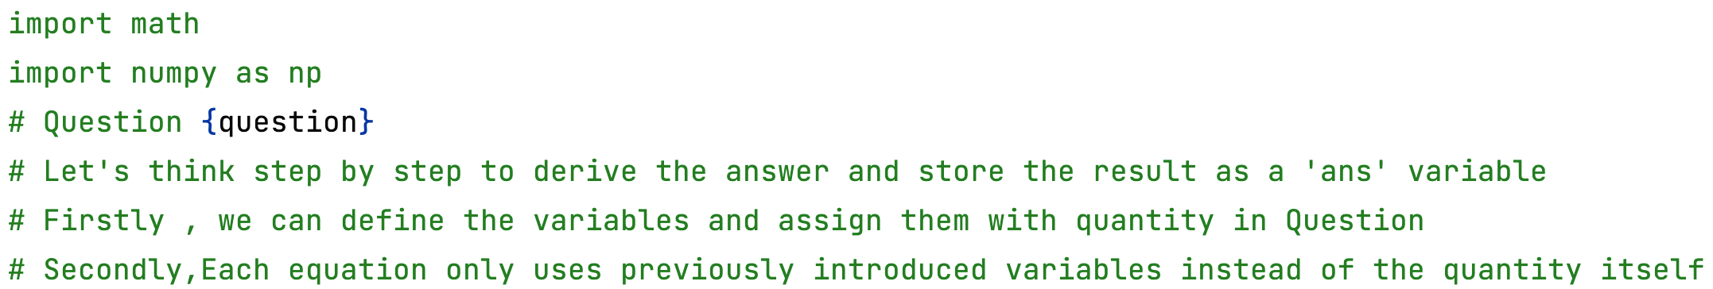
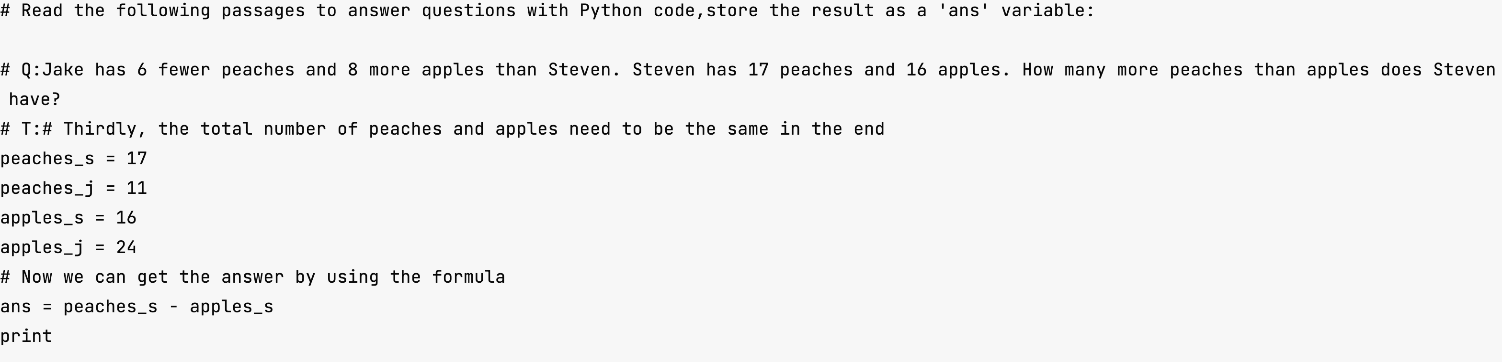
Prompt1
中间过程的数字应该用定义的变量替代
生成的代码是rationales

Slide 42
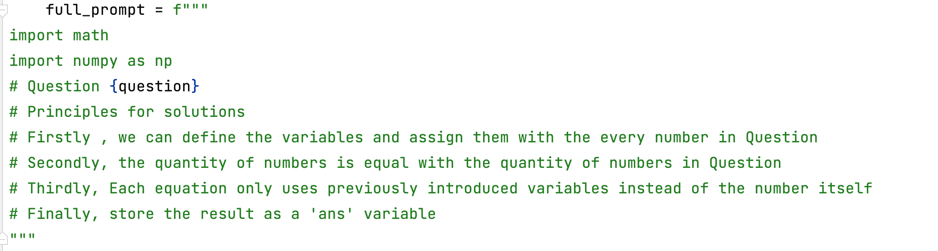
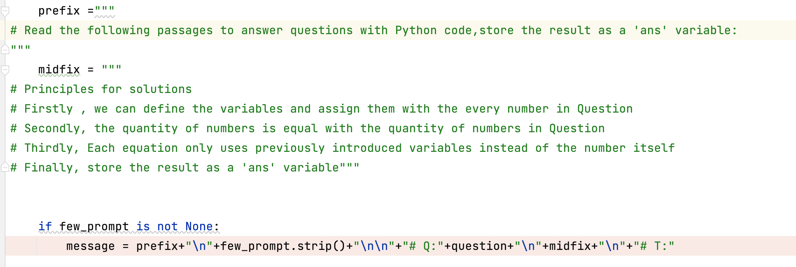
Prompt2
并不会注意到每个变量而且还会出现program null

Slide 43
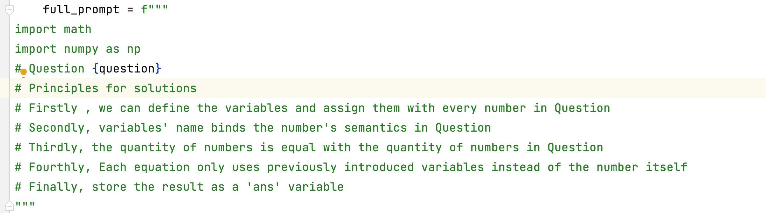
Prompt3
并不会注意到每个变量而且还会出现program null

Slide 44
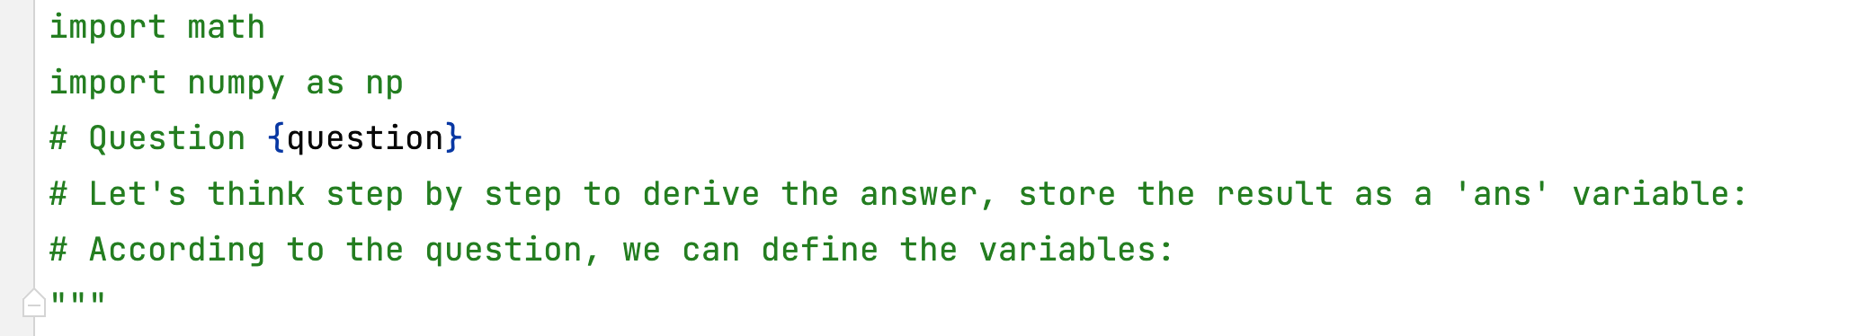
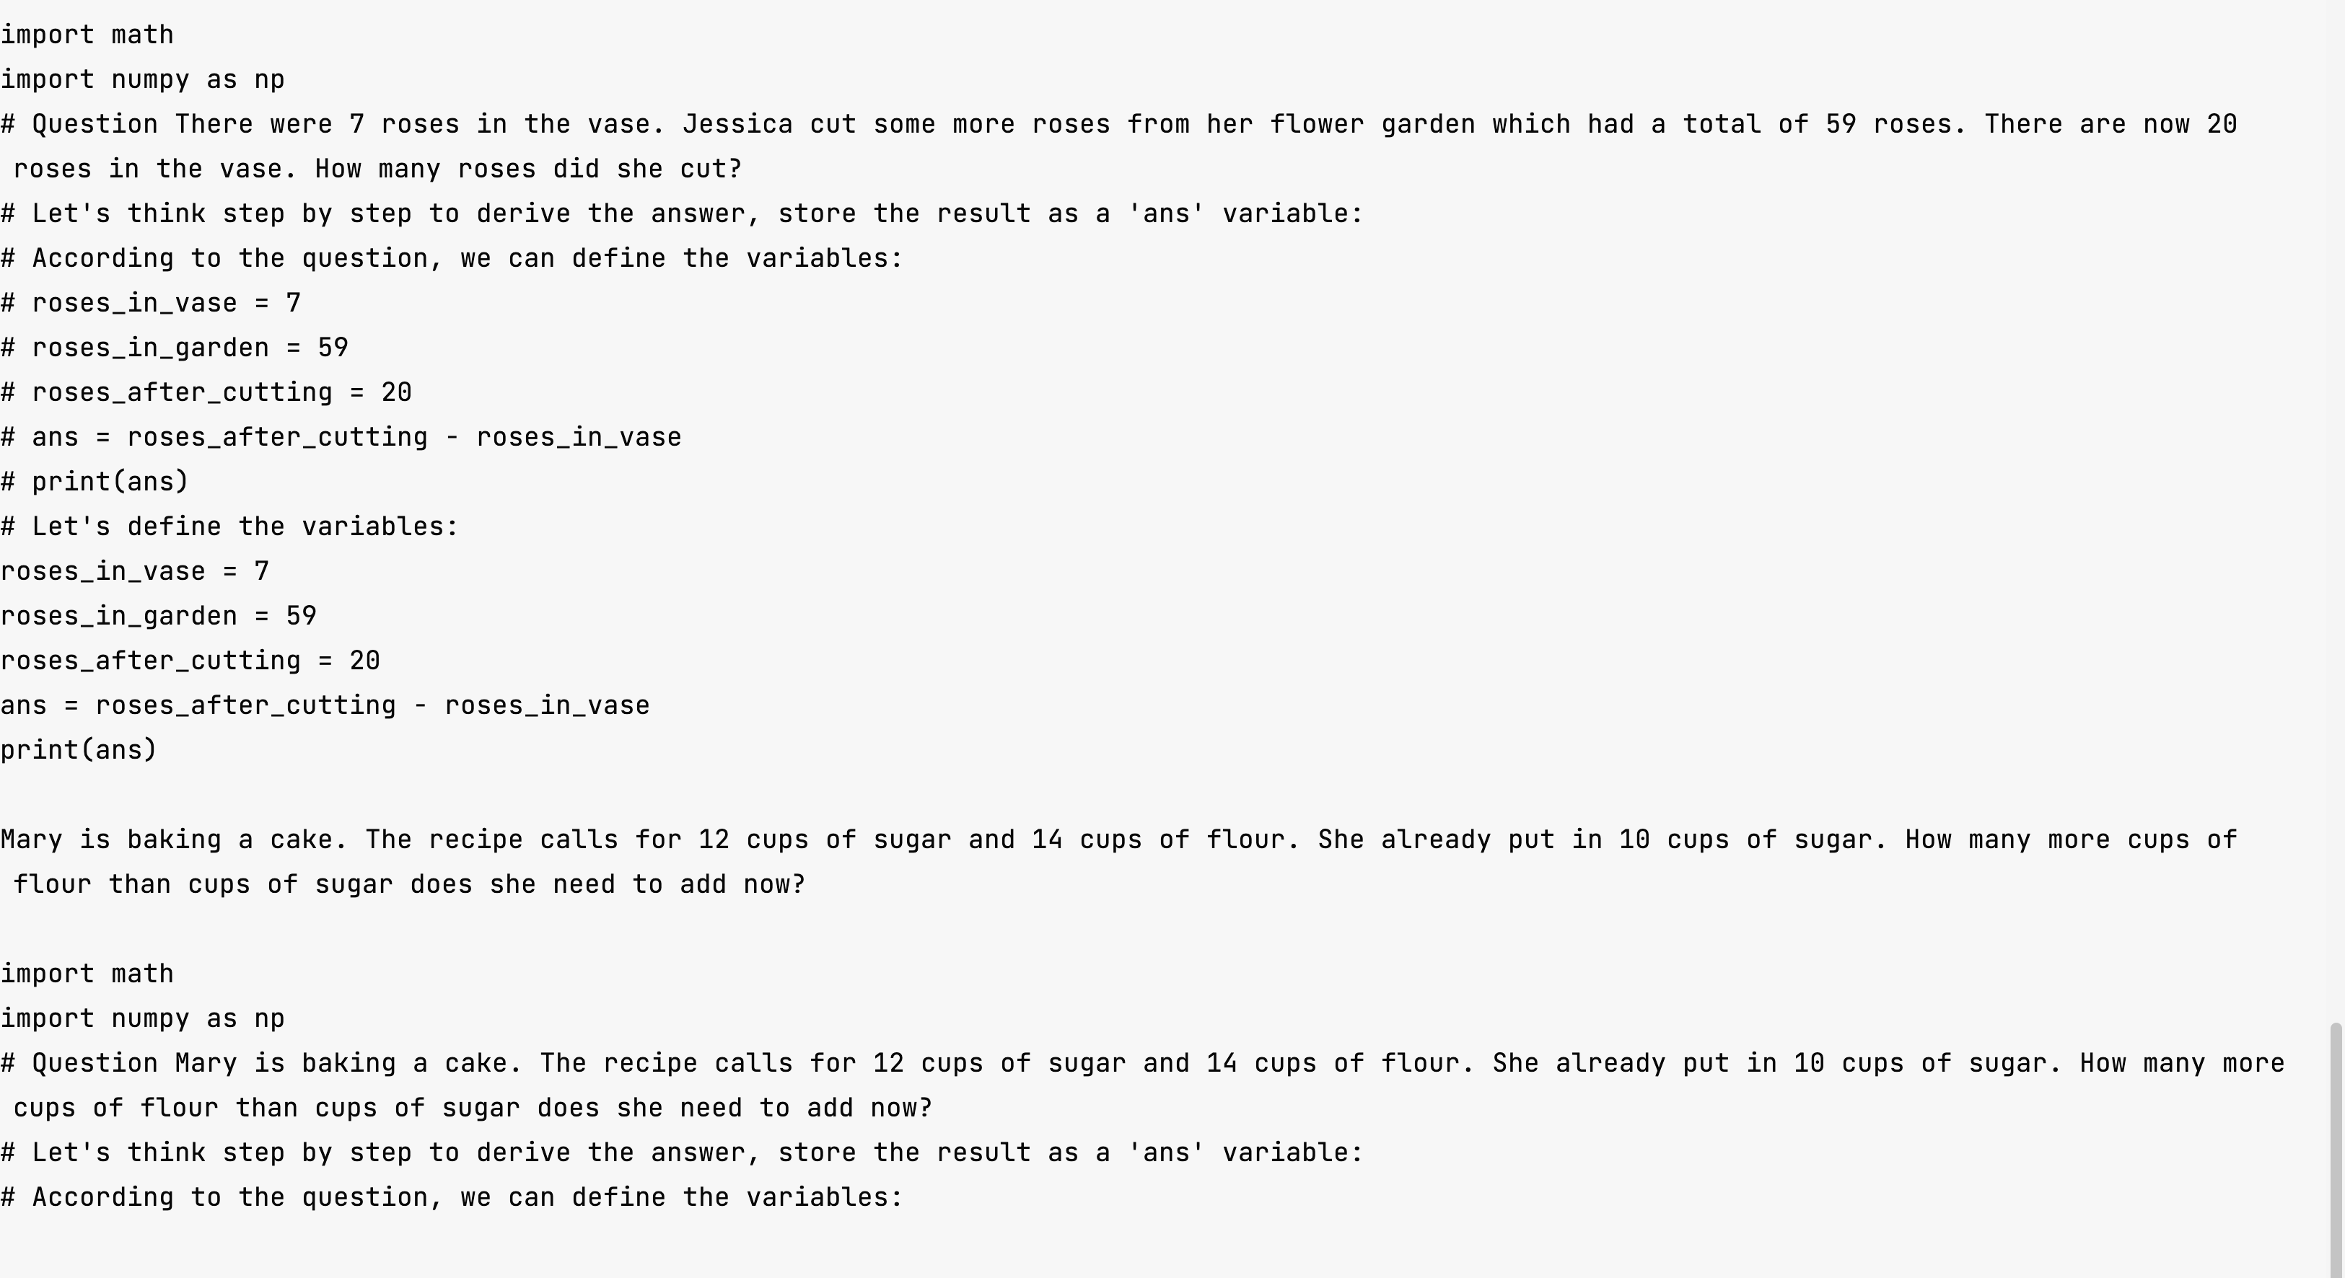
Prompt4
并不会注意到每个变量而且还会出现program null

Slide 45
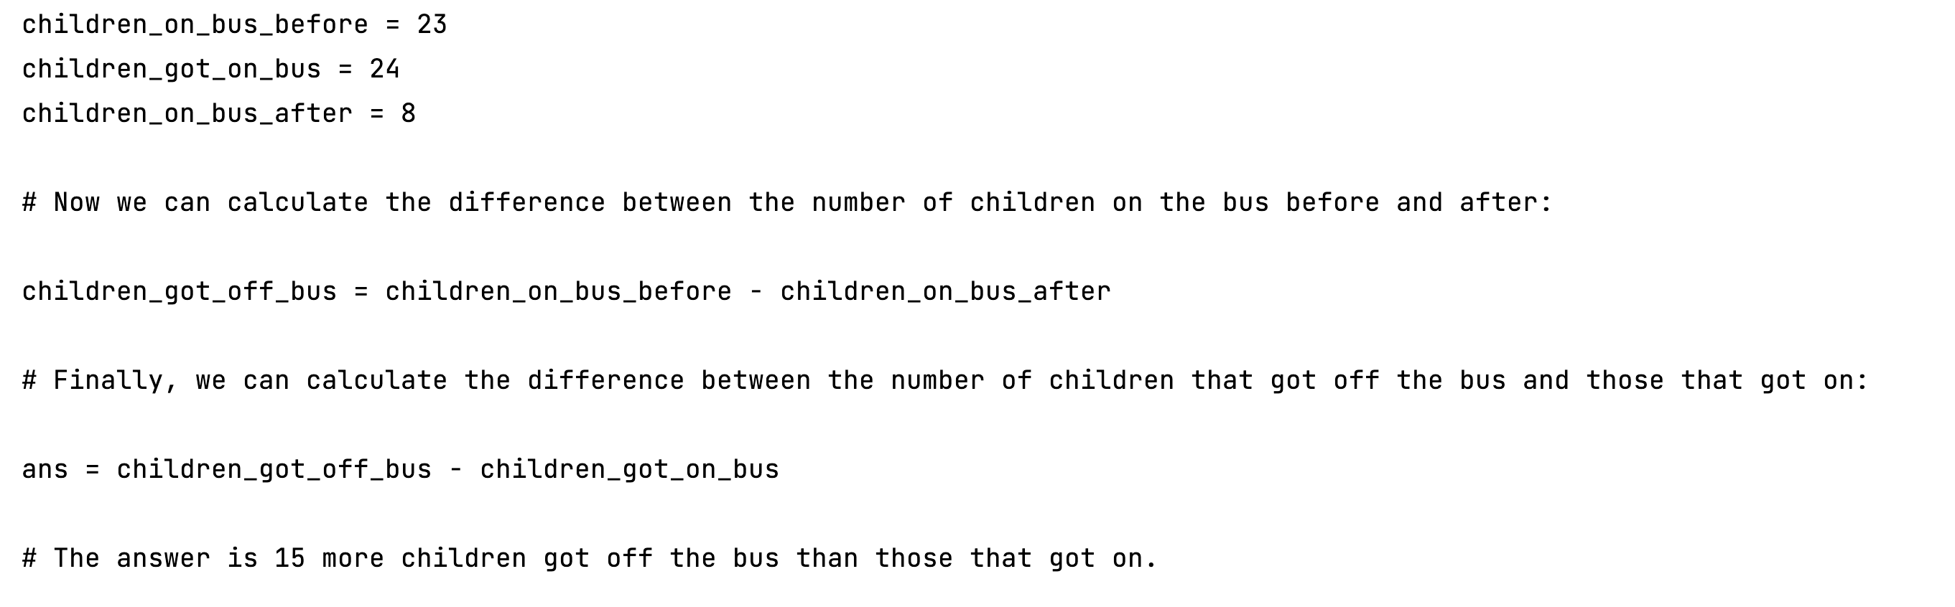
错误问题的解决方案
并不会注意到每个变量而且还会出现program null

Slide 46
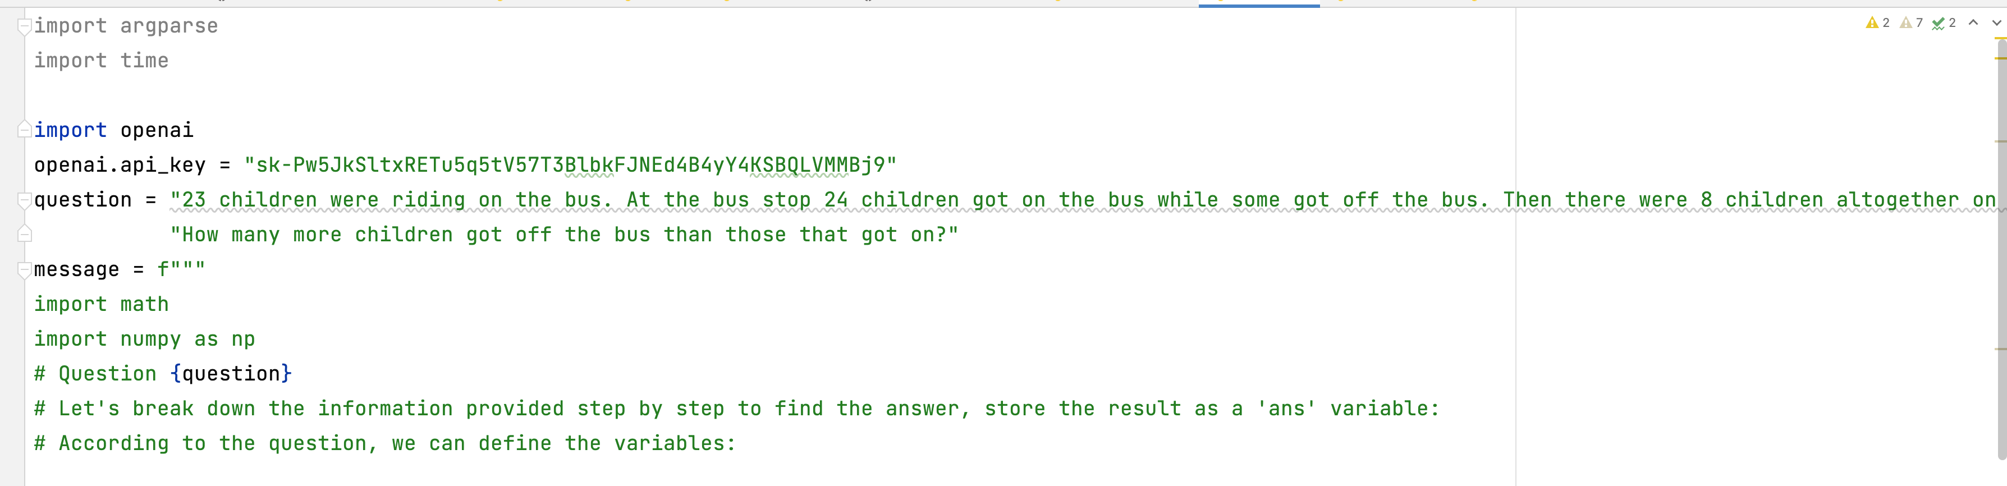
错误问题的解决方案
并不会注意到每个变量而且还会出现program null

Slide 47
错误问题的解决方案
并不会注意到每个变量而且还会出现program null

Slide 48
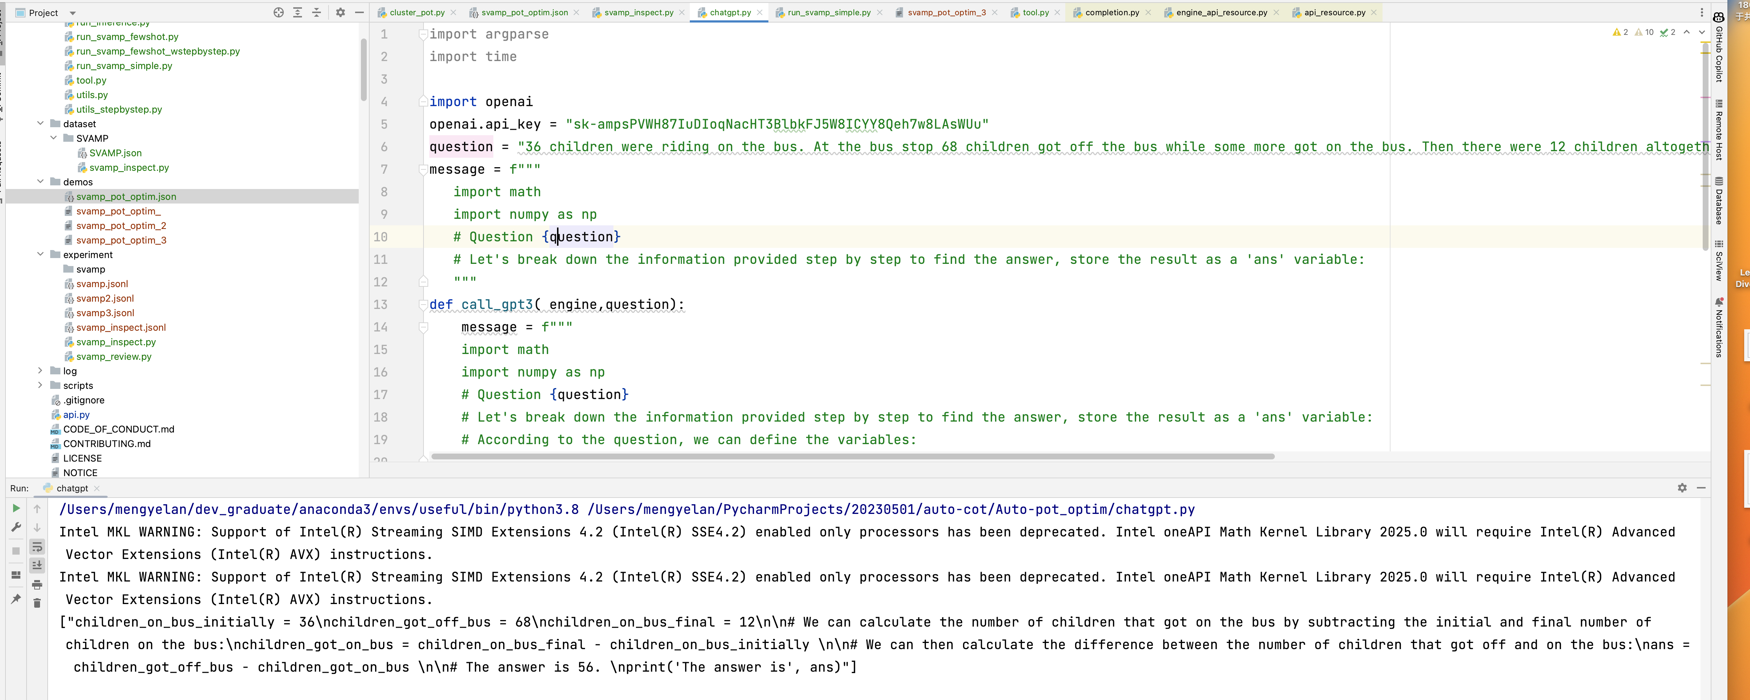
错误问题的解决方案
并不会注意到每个变量而且还会出现program null

Slide 49
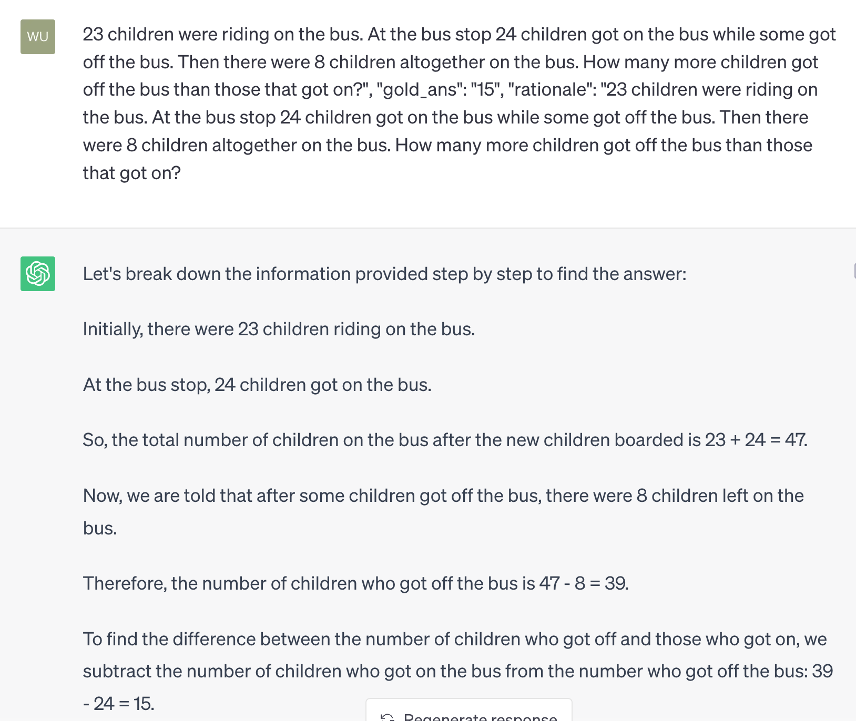
一个奇怪的问题
并不会注意到每个变量而且还会出现program null

Slide 51
THANKS

